Slide 1
Object Oriented Programming
Prof. Varsha Dange

Slide 2
Section 2 Lecture – 24
Prof. Varsha Dange

Slide 3
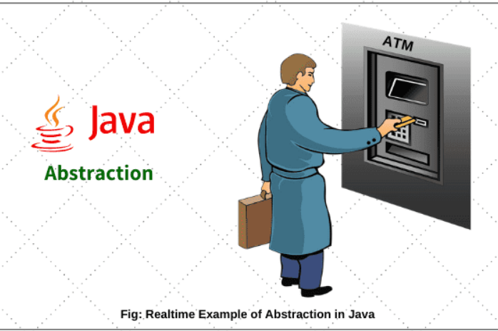
Abstraction in Java
Abstraction is a process of hiding the implementation details and showing only functionality to the user.
it shows only essential things to the user and hides the internal details.
Ex-ATM

Slide 4
How to achieve Abstraction in Java
There are two ways to achieve or implement abstraction in java program. They are as follows:
Abstract class (0 to 100%)
Interface (100%)

Slide 5
Abstract class in Java
An abstract class in Java is a class, which is declared with an abstract keyword. It is just like a normal class but has two differences-
1.We cannot create an object of this class. Only objects of its non-abstract (or concrete or normal) sub-classes can be created.
2. It can have zero or more abstract methods which are not allowed in a non-abstract class (concrete class).
To use this class, you need to create another class that extends this class and provides the implementation of abstract methods

Slide 6
Abstract class in Java
Key points:
Abstract is a non-access modifier in java which is applicable for classes, interfaces, methods, and inner classes .
It represents an incomplete class that depends on subclasses for its implementation.
Creating subclass is compulsory for abstract class.
A non-abstract class is sometimes called a concrete class.
An abstract concept is not applicable to variables.

Slide 7
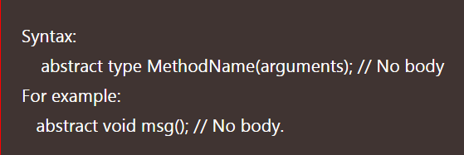
Abstract Methods in Java
A method that is declared with abstract modifier in an abstract class and has no implementation (means no body) is called abstract method in java.
It is Incomplete method
It has simply a signature declaration followed by a semicolon.
Its implementation should be provided by the sub classes.
**A concrete method is a method which has always the body. It is also called a complete method in java.

Slide 8
Abstract Methods in Java
An abstract class must be extended and abstract method must be overridden.
A class has abstract methods then it must be a declared as abstract class
The class which is extending abstract class must override all the abstract methods.
Example

Slide 9
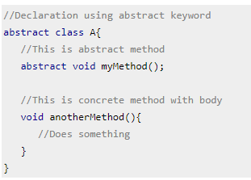
Declaration of Abstract class
Example

Slide 10
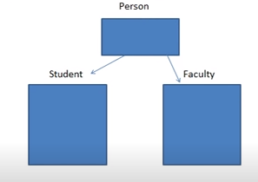
Why Abstract class in Java?
Abstract class is used to declared common characteristics of sub classes .

Slide 11
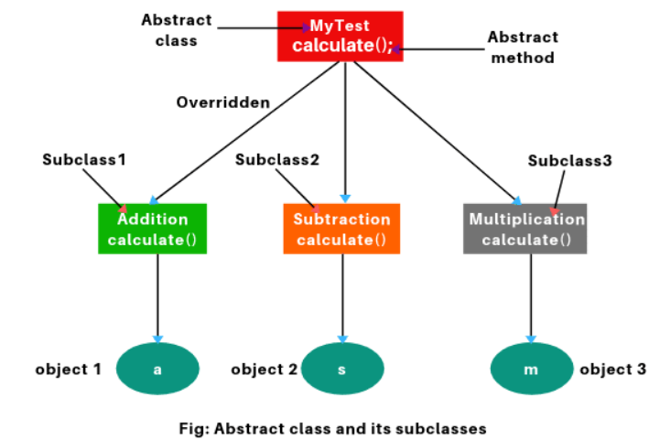
Abstract Methods in Java
Example

Slide 12
Features of Abstract class in Java
Abstract class is not a pure abstraction in java.
In Java, object creation is not possible for an abstract class because it is a partially implemented class, not fully implemented class.
It can have one or more abstract methods or non-abstract methods (or concrete methods) or combination of both methods.
Abstract class allows to define private, final, static and concrete methods.
It can have constructor .
Abstract class does not support multiple inheritance in java but allows in interfaces.
It can implement one or more interfaces in java.
Example

Slide 13
Rules of Abstract class in Java
Class must be declared with abstract keyword.
We cannot instantiate an abstract class
but we can create object of subclass of the abstract class and they must implement abstract method.
If any method is abstract in a class, the class must be declared as abstract.
To use methods declared in an abstract class, the abstract class must be extended by an ordinary class and must implement (override) all abstract methods in that ordinary class.
Inside the abstract class, we can create any number of constructors.
If you do not create a constructor, the compiler will create a default constructor.

Slide 14
contd…
Why abstract class has constructor even though we cannot create object?
We cannot create an object of abstract class but we can create an object of subclass of abstract class.
When we create an object of subclass of an abstract class, it calls the constructor of subclass.
This subclass constructor has super in the first line that calls constructor of an abstract class.
the constructors of an abstract class are get called from constructor of its subclass.

Slide 15
Problem stmt
A Company manufactures Vehicles, which could be a Helicopter, a Car, or a Train depending on the customer’s demand. Each Vehicle instance has a method called move, which prints on the console the nature of movement of the vehicle.
For example,
the Helicopter Flies in Air,
the Car Drives on Road and
the Train Runs on Track.
Write a program that accepts input from the user on the kind of vehicle the user wants to order, and the system should print out nature of movement. Implement all Java coding best practices to implement this program.

